Slide 1

Fast Tax System

Slide 2
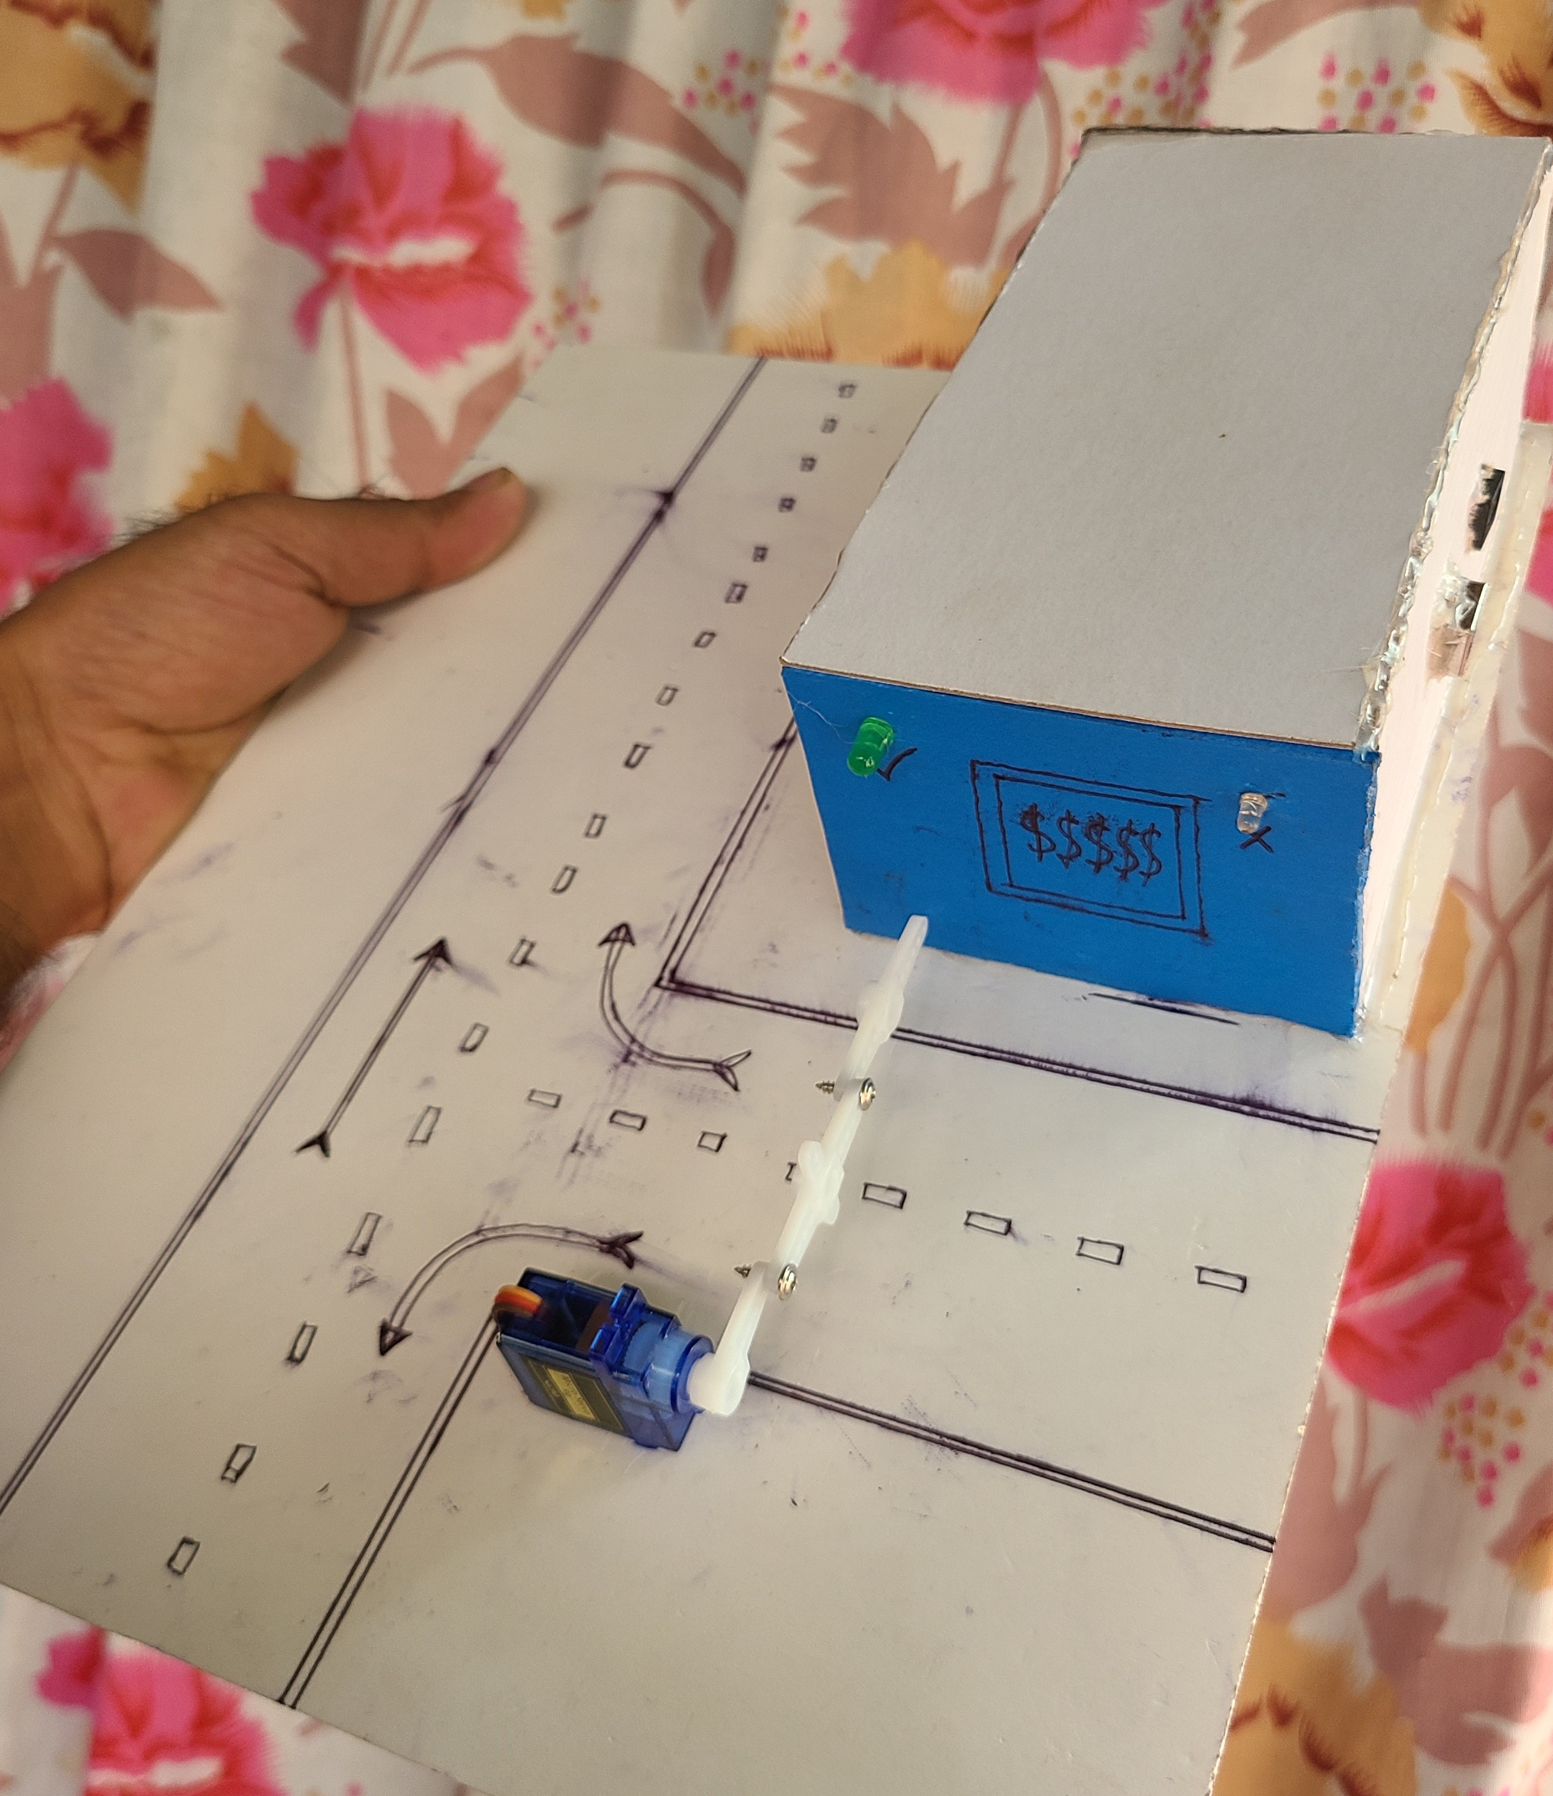
Introduction
THE FAST TAX SYSTEM IS A MODERN TOLL COLLECTION SOLUTION DESIGNED TO STREAMLINE THE TOLL PAYMENT PROCESS AT TOLL PLAZAS, SIGNIFICANTLY RE-DUCING CONGESTION AND ENHANCING VEHICLE FLOW.

Slide 3

Pr0ject overview
THE FAST TAX SYSTEM INTEGRATES SEVERAL ADVANCED TECHNOLOGIES AND FEATURES Such as :
RFID (Radio-Frequency Identification): AUTOMATICALLY DETECTS VEHICLES, AL
LOWING TOLL CHARGES TO BE APPLIED SEAMLESSLY AS VEHICLES PASS THROUGH.
Prepaid Toll System: ALLOWS VEHICLE OWNERS TO MAINTAIN A PREPAID ACCOUNT
FOR TOLL PAYMENTS, WHICH IS AUTOMATICALLY DEBITED UPON PASSING
THE TOLL GATE.
Digital Payment Integration: SUPPORTS A WIDE RANGE OF DIGITAL PAYMENT OP
TIONS, INCLUDING BKASH, UPAY, ROCKET, NAGAD, AND OTHER MAJOR DI
GITAL FINANCIAL SERVICES, PROVIDING USERS WITH THE FLEXIBILITY TO
CHOOSE THEIR PREFERRED PAYMENT METHOD.

Slide 4
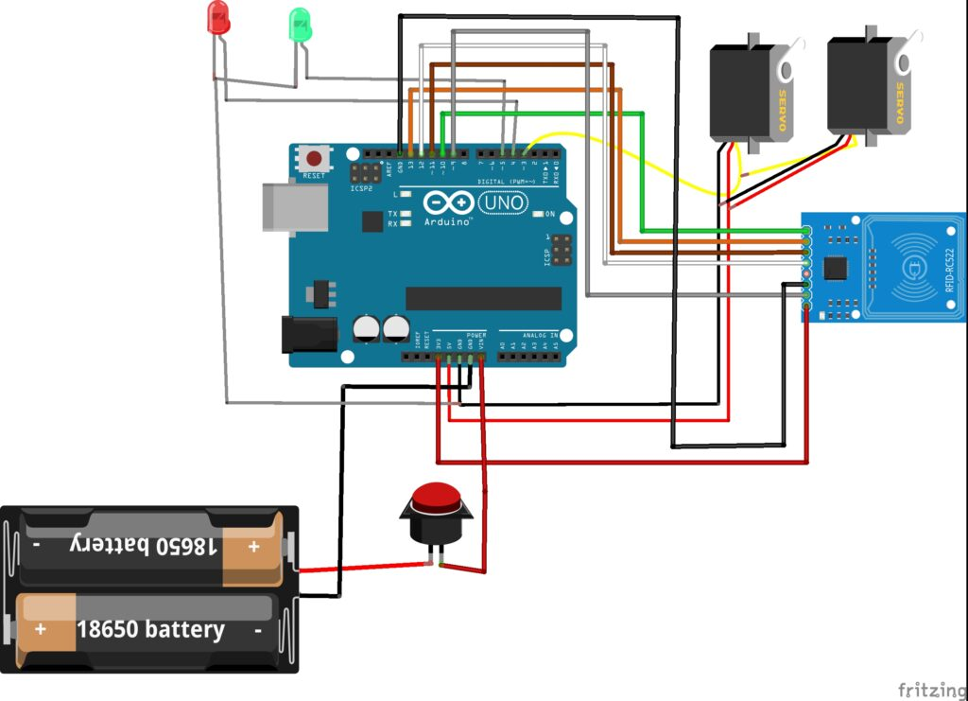
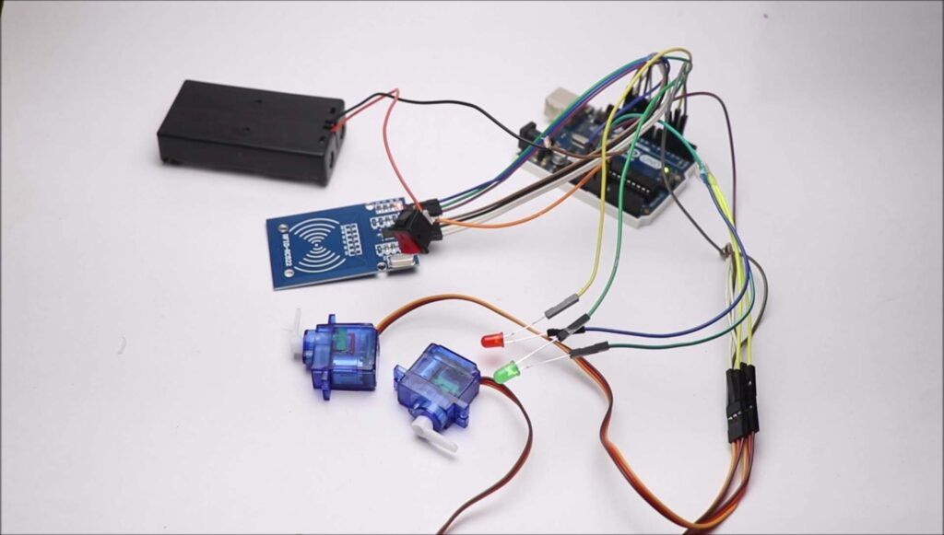
Project overview
Here is the circuit diagram which makes this project.
I have given a step-by-step explanation of how to make connections between different components.
You might need to connect the power from the battery.
Tap the registered tag and if the green light and servo move the circuit is correct
Different tag red led glows
We will start with RFID sensor module.
Pin with Arduino connections
Sda to D10
Sck to D13
Mosi connects to D11
Mi with D12, Gnd to ground, Rst to D9
3.3v power pin to 3.3v on Arduino
Green and red led negative pins to gnd on uno board.

Slide 5
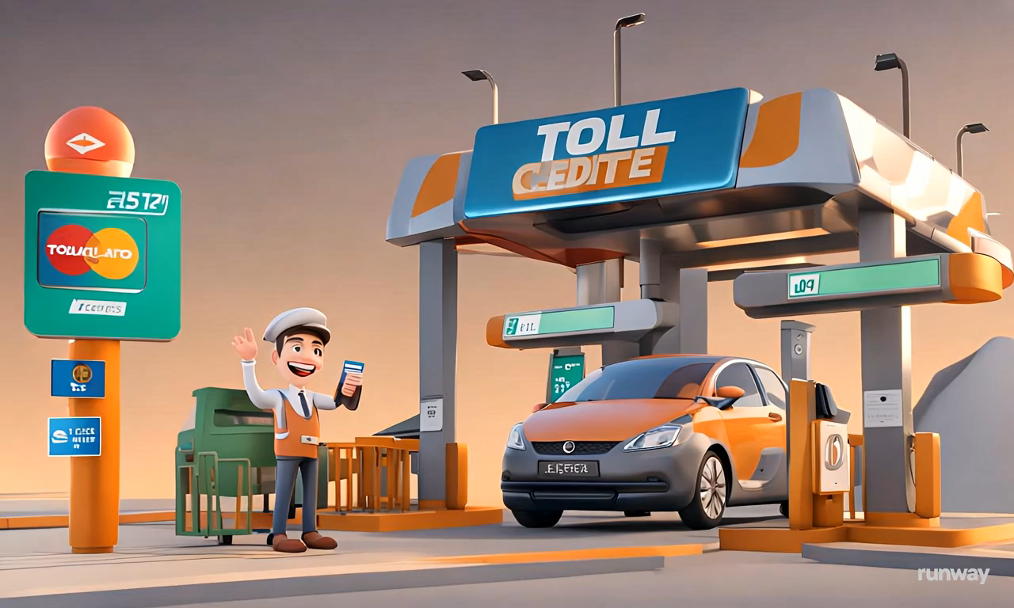
Project benefits
Improved Efficiency
Convenient Digital Payments Enhanced user experience.
Reduced Operational Costs & Environmental Advantages.

Slide 6
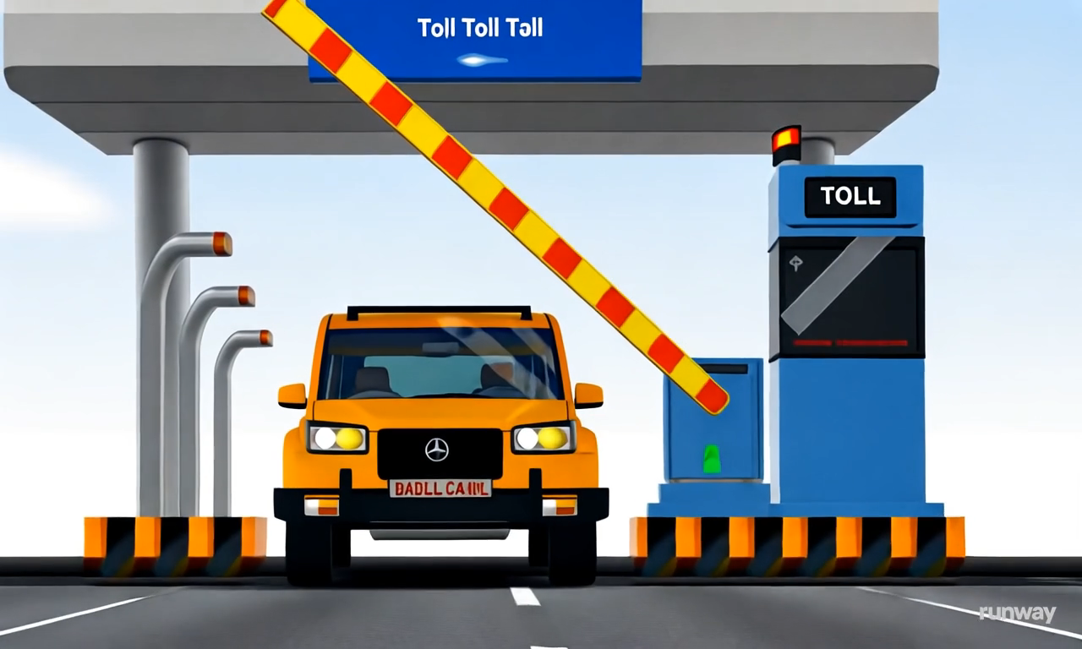
Advantage
With this product, Adatum Corporation is positioned for success in the dynamic market.
With a focus on innovation, user experience, and strategic growth, we anticipate reaching new heights in the coming year.
Our commitment to user satisfaction underscores every aspect of our operations
Strong market positioning
Robust growth strategy
Innovative product development
Commitment to user satisfaction

Slide 7
Conclusion
THE FAST TAX SYSTEM IS AN INNOVATIVE TOLL COLLECTION PLATFORM THAT MODERNIZES TOLL PLAZA OPERATIONS THROUGH ADVANCED TECHNOLOGIES AND COMPREHENSIVE DIGITAL PAYMENT SUPPORT. ITS EMPHASIS ON SEAMLESS TRAN SACTIONS, INCLUDING FOR EMERGENCY VEHICLES, POSITIONS IT AS A CRITICAL UPGRADE FOR TOLL MANAGEMENT SYSTEMS. BY INCORPORATING POPULAR DI GITAL PAYMENT OPTIONS LIKE BKASH, UPAY, ROCKET, AND NAGAD, THE SYSTEM ALIGNS WITH CONTEMPORARY PAYMENT TRENDS, MAKING TOLL PAYMENTS EASIER AND MORE ACCESSIBLE FOR ALL USERS.

Slide 8
thank you

